Slide 1

IBM Lunch & Learn Series 2024
Enhancing Performance with SQL Stored Procedures & UDF

Slide 2

Topics to be covered
Stored Procedure – the what why & how
User Defined Functions – the what why & how
Enhancing Performance for SPs and UDFs
Use Cases

Slide 3

Objectives
Take away from the session:
General overview of Stored Procedures & UDFs
Understanding how UDFs and SPs perform
Best practices to use which one over the another.
Session is useful for:
RPG Developers
DB2 SQL Developers
IBMi Business owners trying to modernize

Slide 4

what is
Stored Procedure
A Stored Procedure is a compiled program that can execute SQL statements.
Program object is stored on the DB2 database.
It is like running STRSQL and exec-sql but with some special powers
Stored Procedure can be called from any application program (Java or Python or any front-end app) that has access to the DB2 database.
It can be called from IBMi command line as well.
Notes:
Stored at a local or remote Db2 server.
Special Powers? Loops, Conditional Logic, Code Blocks & passing parameters
You can invoke a stored procedure from an application program or from the command line processor.

Slide 5

why
Stored Procedure
Reduces network traffic
No Locks on resources across the network transmissions
Provides Centralized code
Provides Security & Integrity
Serves Code Reusability
Easy to understand for cross-platform users
Modernize by opening-up the IBMi to front end
A good skillset to have for IBMi’ers
Notes:
Displaying 100s of records on front end.
May cause increased loading time
Hard to manage the SQL Queries across various front end screens
End Users can manipulate SQL Statements & Variables
Encapsulation of business logic

Slide 6
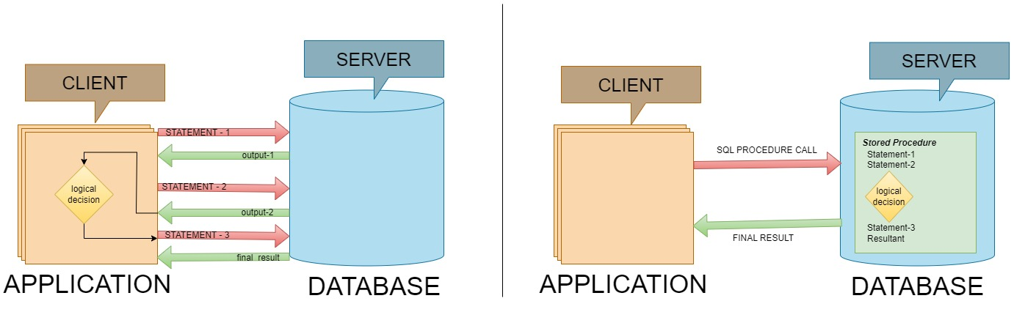
why
Stored Procedure
Without Stored Procedure
With Stored Procedure

Slide 7
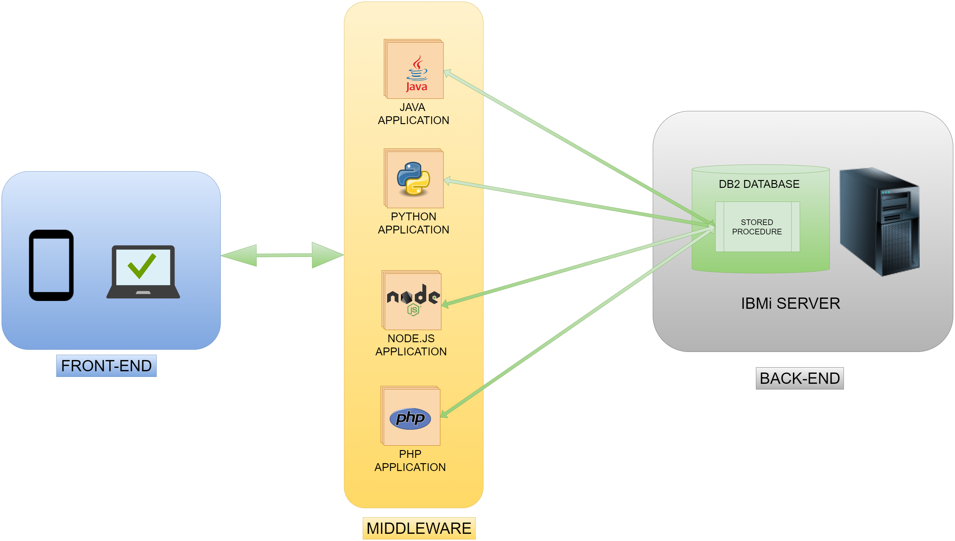
why
Stored Procedure
Modernization & Security

Slide 8
types of
Stored Procedure
INTERNAL STORED PROCEDURE | EXTERNAL STORED PROCEDURE
Based on procedural extensions to the SQL Language. | Based on high-level-language like C, CL, RPG and COBOL
Straight forward database manipulation | Allows Complex & Sophisticated processing.
For existing systems, business logic need to be ported to SQL Language. | Existing code can be reused.
Limited with SQL Procedural Language | Can provide access to native IBMi functions.
Notes:
Usage of arrays, data structures, built-in-functions, sub-procedures
Core of the existing business logic can be encapsulated for clients to use.

Slide 9
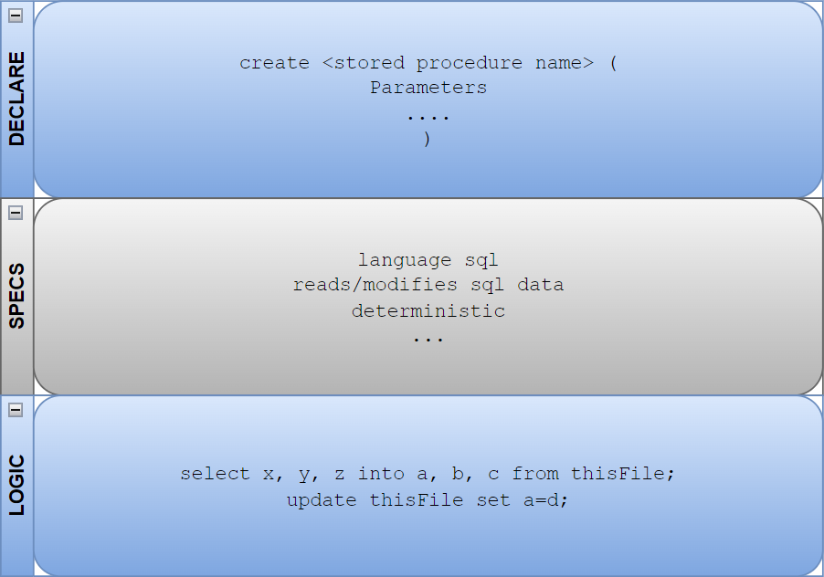
structure of
Stored Procedure
Notes:
Usage of arrays, data structures, built-in-functions, sub-procedures
Core of the existing business logic can be encapsulated for clients to use.

Slide 10
how to
Stored Procedure
Let’s see it in action
Notes:
Usage of arrays, data structures, built-in-functions, sub-procedures
Core of the existing business logic can be encapsulated for clients to use.

Slide 11
what is
User Defined Function
UDFs are custom functions created by developers within the DB2 database on IBMi.
Can encapsulate SQL logic and can return a single value (scalar) or an entire table (table-valued).
Program object is stored on the DB2 database.
It can be invoked only in SQL Statements
Notes:
Stored at a local or remote Db2 server.
Special Powers? Loops, Conditional Logic, Code Blocks & passing parameters
You can invoke a stored procedure from an application program or from the command line processor.

Slide 12
why
User Defined Function
Modularity & Code Reusability
Performance Optimization
Code abstraction & Encapsulation
Data formatting on the fly
Notes:
Breakdown complex logic into smaller, reusable units
UDFs can improve query performance by precomputing results or handling repetitive tasks efficiently. Non-deterministic
Execute common calculations or transformations efficiently.
Think it like the BIF in RPGLE.

Slide 13
how to
User Defined Function
Let’s see it in action
Notes:
Usage of arrays, data structures, built-in-functions, sub-procedures
Core of the existing business logic can be encapsulated for clients to use.

Slide 14
Enhancing Performance
How the stored procedure is compiled and executed
SQL Stored Procedure
Procedural Logic
SQL Queries
SQL Function
SQL Queries
Notes:
Before discussing how to improve the performance of SQL procedures, we should discuss how they are compiled upon the execution of the CREATE PROCEDURE statement.
SQL Procedure – Procedural logic + SQL Statement. Context switch is required . Takes more time
SQL Procedure – SQL Query Unlike what happens in SQL procedures, procedural statements in SQL functions are not executed in a different layer than dataflow statements. Therefore, there is no context switch every time control flows from a procedural to a dataflow statement or vice versa.

Slide 15
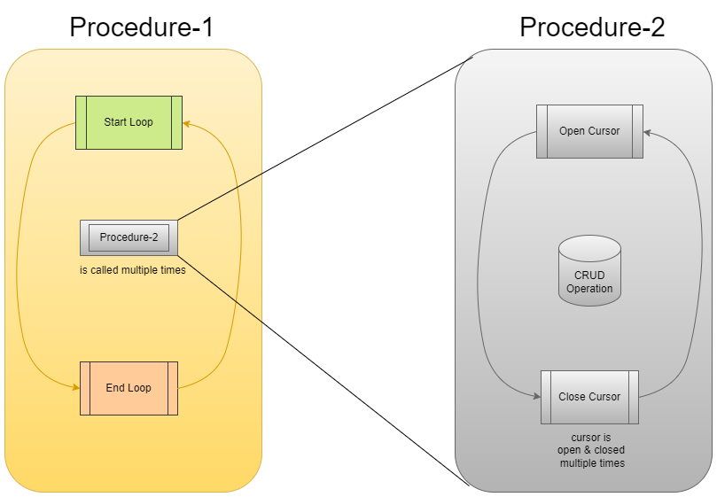
Enhancing Performance
Notes:
Before discussing how to improve the performance of SQL procedures, we should discuss how they are compiled upon the execution of the CREATE PROCEDURE statement.
SQL Procedure – Procedural logic + SQL Statement. Context switch is required . Takes more time
SQL Procedure – SQL Query Unlike what happens in SQL procedures, procedural statements in SQL functions are not executed in a different layer than dataflow statements. Therefore, there is no context switch every time control flows from a procedural to a dataflow statement or vice versa.

Slide 16
Enhancing Performance
Decision for Stored procedure or Function
Stored Procedure
CREATE PROCEDURE GetPrice (IN Vendor CHAR&(20&),
IN Pid INT,
OUT price DECIMAL(10,3))
LANGUAGE SQL
BEGIN
IF Vendor = ‘Vendor 1’;
THEN SET price = (SELECT ProdPrice
FROM V1Table
WHERE Id = Pid);
ELSE IF Vendor = ‘Vendor 2’;
THEN SET price = (SELECT Price
FROM V2Table
WHERE Pid eq; GetPrice.Pid);
END IF;
END
User Defined Function
CREATE FUNCTION GetPrice (Vendor CHAR(20),
Pid INT)
RETURNS DECIMAL(10,3)
LANGUAGE SQL
BEGIN
DECLARE price DECIMAL(10,3);
IF Vendor = 'Vendor 1' THEN
SET price = (SELECT ProdPrice
FROM V1Table
WHERE Id = Pid);
ELSE IF Vendor = 'Vendor 2' THEN
SET price = (SELECT Price
FROM V2Table
WHERE Pid = GetPrice.Pid);
END IF;
RETURN price;
END

Slide 17
Enhancing Performance
Utilize Service Program Object (*SRVPGM & PGM )
*SRVPGM
Create Procedure Add_SrvPgm
( IN p1 INT,
IN n INT,
OUT o1 INT
)
Language SQL
Program Type SUB
Begin
Declare v1 INT;
SET v1=ABSVAL(n);
SET o1= p1+v1;
End;
*PGM
Create Procedure Add_MainPgm
( IN p1 INT,
IN n INT,
OUT o1 INT
)
Language SQL
Program Type MAIN
Begin
Declare v1 INT;
SET v1=ABSVAL(n);
SET o1= p1+v1;
End;
Notes:
The usage of a service program object will provide a small performance boost when the SQL stored procedure is called. No changes are needed to the applications that invoke the SQL stored procedure. The PROGRAM TYPE SUB clause is not supported for SQL Triggers or Functions

Slide 18
Enhancing Performance
Minimize calls to other Stored procedures
Combine sequences of complex SET statements into one statement
Multiple Statement
Example 1:
SET var1 = 'A ‘;
SET var2 = 'B ‘;
SET var3 = TRIM(var1) || TRIM(var2);
Example 2:
INSERT INTO tab_comp VALUES (item1, price1, qty1); INSERT INTO tab_comp VALUES (item2, price2, qty2); INSERT INTO tab_comp VALUES (item3, price3, qty3);
Single Statement
Example 1:
SET var1 = 'A ', var2 = trim(var1), var3 = TRIM(var1)||TRIM(var2);
Example 2:
INSERT INTO tab_comp VALUES (item1, price1, qty1),
(item2, price2, qty2),
(item3, price3, qty3);

Slide 19
Enhancing Performance
Avoid using temporary variables
With Temporary variables
SET counter = 0;
xLoop:
REPEAT
SET counter = counter + 1;
SET var1 = counter;
SET var2= counter * 7;
SET var3 = counter * 30;
SET var4 = var1 + var2 + var3;
UNTIL counter = 1000
END REPEAT xLoop;
Without Temporary variables
SET counter = 0;
xLoop:
REPEAT
SET counter = counter + 1;
SET var4 = counter + (counter * 7) + (counter*30); UNTIL counter = 1000
END REPEAT xLoop;
Notes:
Memory will be allocated for procedure variables.

Slide 20
Enhancing Performance
Use Integer data type instead of Character for simple flags
Use Integer data types instead of Decimal with zero scale for external SP
Deconstruct complex IF statements
Utilize the Character data type over Variable-Length Character type
Try to avoid the cursor inside the procedure if possible.
Call each stored procedure using its fully qualified name to improve performance: the server name, database name, schema (owner) name, and procedure name. e.g. SchemaName.TableName.ColumnName
Notes:
When the cursor is pseudo closed, the underlying file and ODP are left open. All record locks are released; however, a shared lock still appears on the file. Db2 for i can then reuse the cursor as needed without the cost of a full open of the file.

Slide 21
Enhancing Performance
In the script that creates each stored procedure, explicitly specify which roles are allowed to execute the Stored Procedures e.g., public or whatever.
Use sysmessage, sp_addmessage, and placeholders rather than hard-coded error messages.
Be careful with an error in a UDF. When an error occurs in a UDF, execution of the function is aborted immediately and so is the query that invoked the UDF - but @@error is 0! You may want to define handlers.
Notes:
When using sp_addmessage and sysmessages, always use error message number of 50001 or greater.

Slide 22
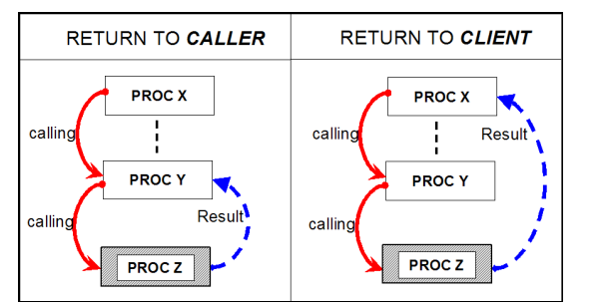
Enhancing Performance
Return to caller vs Return to client
WITH RETURN TO CALLER : – DECLARE c1 CURSOR FOR WITH RETURN TO CALLER SELECT * FROM t1
– SET RESULT SETS WITH RETURN TO CALLER
FOR ARRAY :array1 FOR :hv1 ROWS
WITH RETURN TO CLIENT :
– DECLARE c1 CURSOR FOR WITH RETURN TO CLIENT SELECT * FROM t1
– SET RESULT SETS WITH RETURN TO CLIENT FOR CURSOR c1

Slide 23
Enhancing Performance
Arrays :- An array is an ordered set of elements of a single built-in data type.
Arrays can be used only in the following contexts:
Parameters to SQL functions
RETURN data types from SQL functions
Parameters to SQL procedures
SQL variables that are declared in SQL functions
SQL variables that are declared in SQL procedures
-D
Declaring Array of Integer
CREATE TYPE INTARRAY AS INTEGER ARRAY[100];
-- IN AN SQL PROCEDURE, DEFINE ARRAY INTA OF THE INTARRAY TYPE
DECLARE INTA INTARRAY;
Declaring Array of Char
CREATE TYPE CHARARRAY AS CHAR(10) ARRAY[VARCHAR(10)];
-- IN AN SQL PROCEDURE, DEFINE ARRAY CHARA OF THE CHARARRAY TYPE DECLARE CHARA CHARARRAY;

Slide 24
Few points to note
Always compile the code when deploying the stored procedure
Proper usage of Code Blocks (Begin/End) is required for complex logic.
Sysprocs and Catalog tables

Slide 25
Q & A
Thank You!

Slide 26
https://programmers.io/ibmi-ebook/

